Slide 1
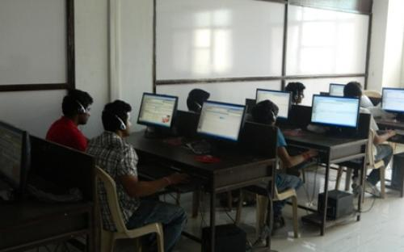



FOSS in Schools

Slide 2

FOSS in Schools
Adoption of some FOSS is now the norm
The bright and open future…
Notes:
The Free Software Foundation position
FSF: “have a moral duty to teach only free software”
-can save money, but this is a secondary benefit
-social mission: teach good citizenship
-permits students to learn how software works
-the habits of helping others and sharing
-”If you bring software to school, you must share it with the other students”
-Software should not implant dependence
-more people aware of the issue and find allies
The dark dark past
4~5 years ago we had a look at iPads in schools
-News was not good, only one device would do
-No sign of any movement
Now days in business and government adoption or admission of the use of FOSS has become the norm and these ideas are spreading into all parts of society
And more and more people are realizing that the future is open, and Programs like ICT in schools expose students to many FOSS options and tools, but we’ll get back to that in a moment

Slide 3
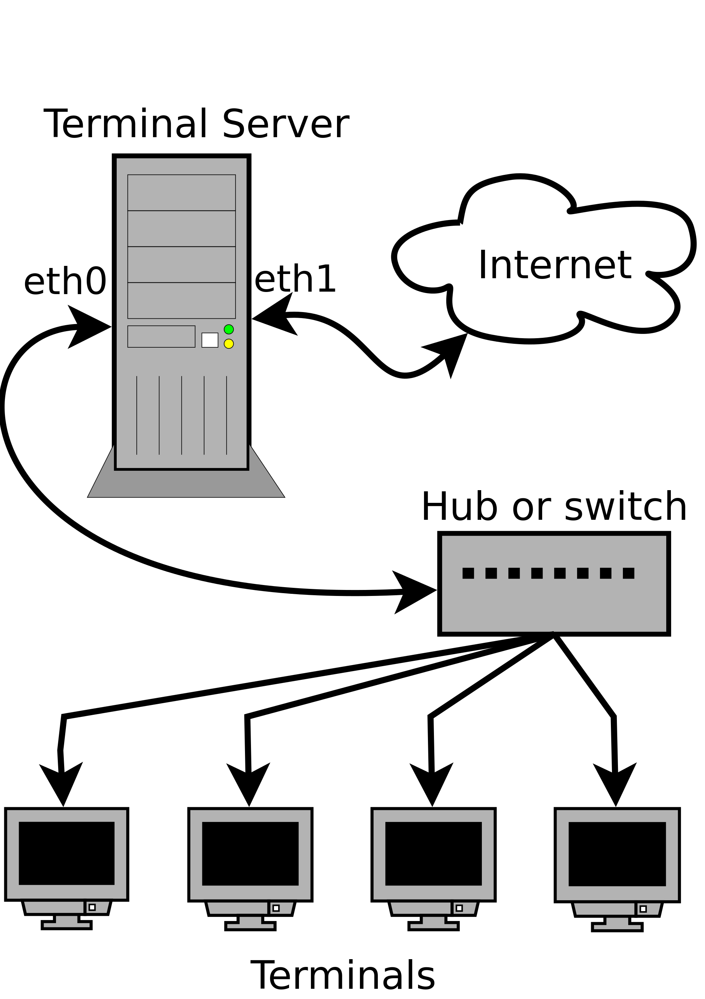
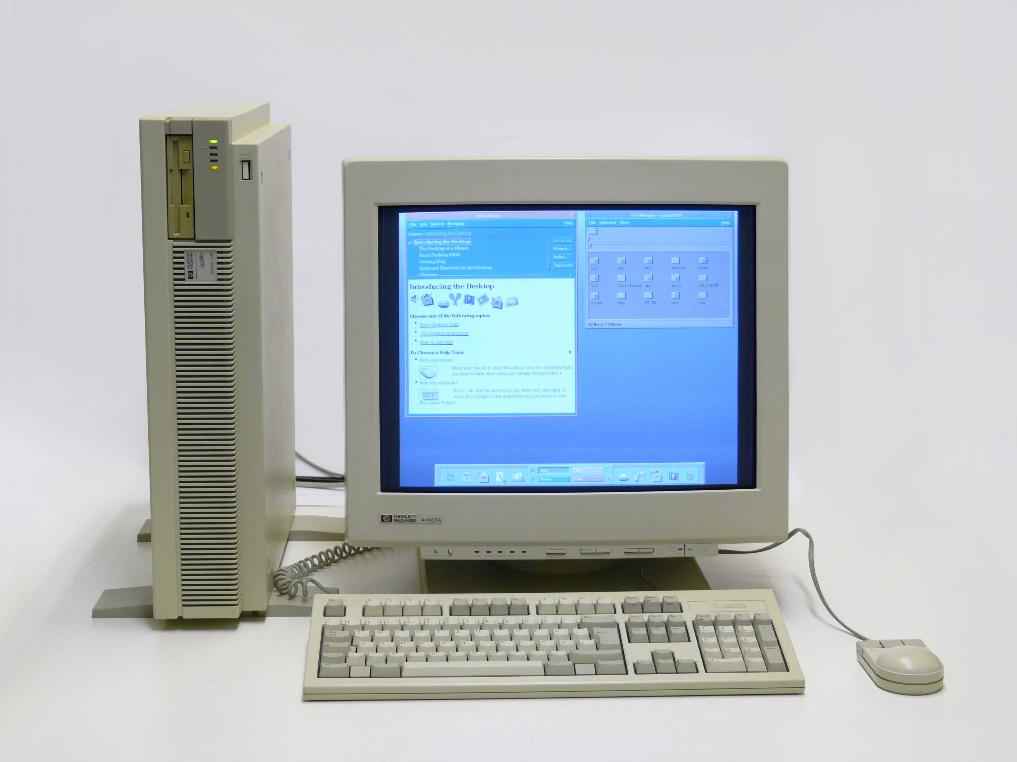



FOSS in Schools
OSV: Benefits of Open Source in Education
Notes:
In adition to those mentioned by the FSF, the OSV also covers the TCO in more depth
Also covers customisation and keeping old hardware working for longer
Like the Linux Terminal Server Project which can be used to setup low cost disk-less workstations without expenditure on hardware or software licensing and enabling the reuse of donated hardware
And the simple fact that Linux provides support for hardware long after the proprietary software companies have given up on it
Linux.org.au also points out that updates are offered often, and at no charge
unparalleled degree of control
open standards
And a recent article gave the example of “when selecting software, the school will preference open source solutions over paid solutions where the functionality or outcome is similar” as a prime example of the kind of guiding principles that help build effective digital schools

Slide 4
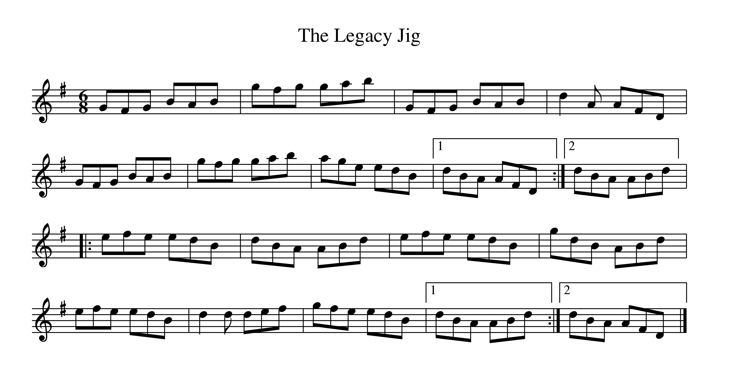
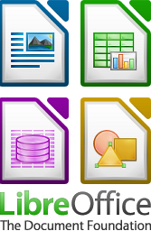
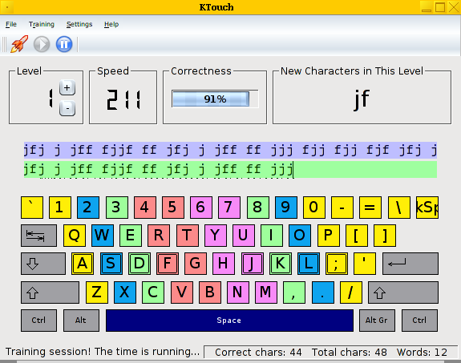

FOSS in Schools
Loads of software
Notes:
Schoolforge offers many FOSS alternatives including:
Music notation software
Word processing and office suites
School Network/Management systems
Quizz and Flashcard software
Spelling, typing and number games
Drawing, Animation and 3D Sketching software
Document management systems
More...

Slide 5
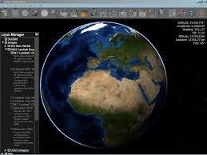
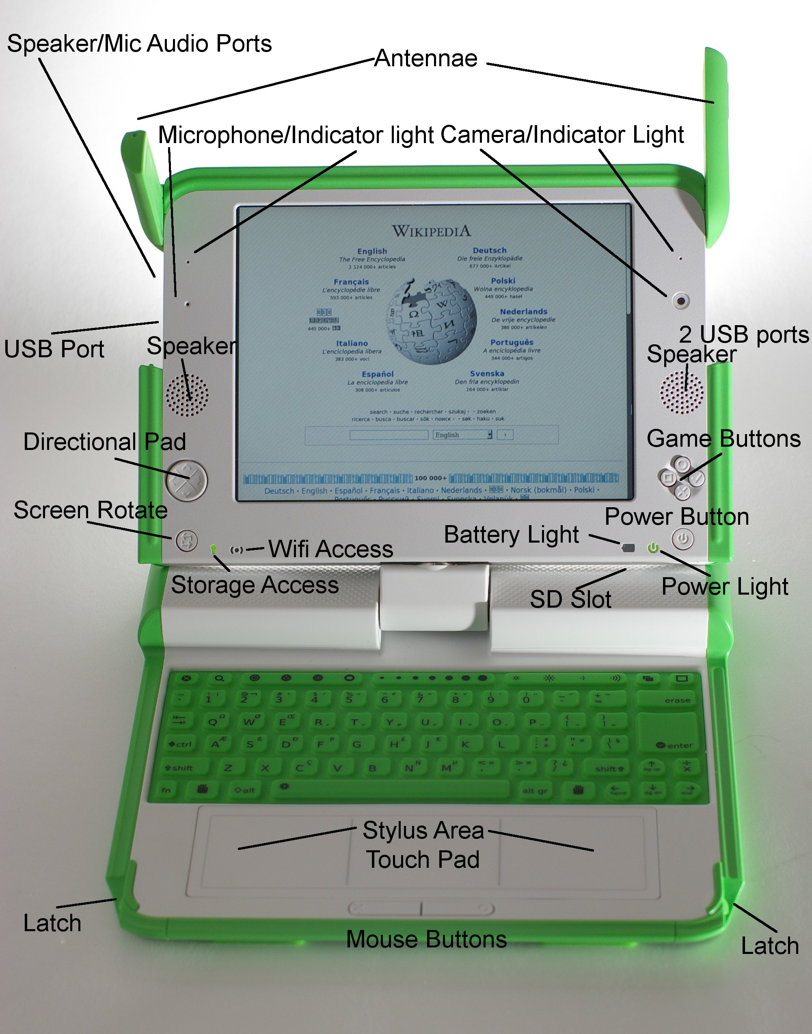
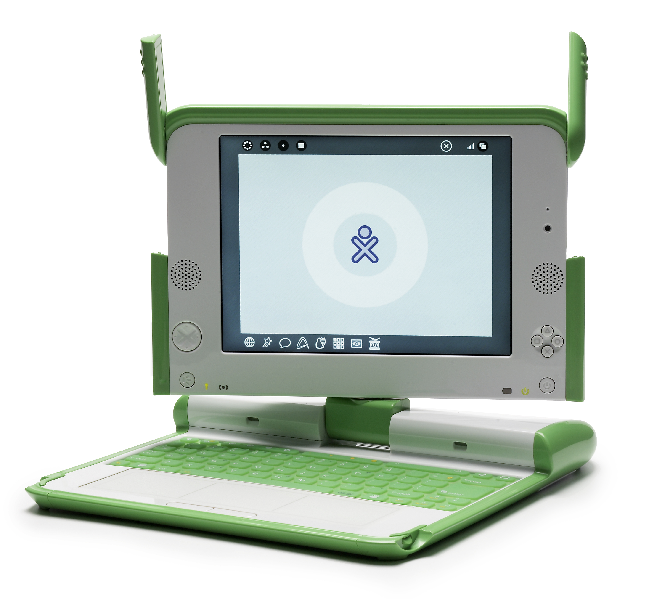
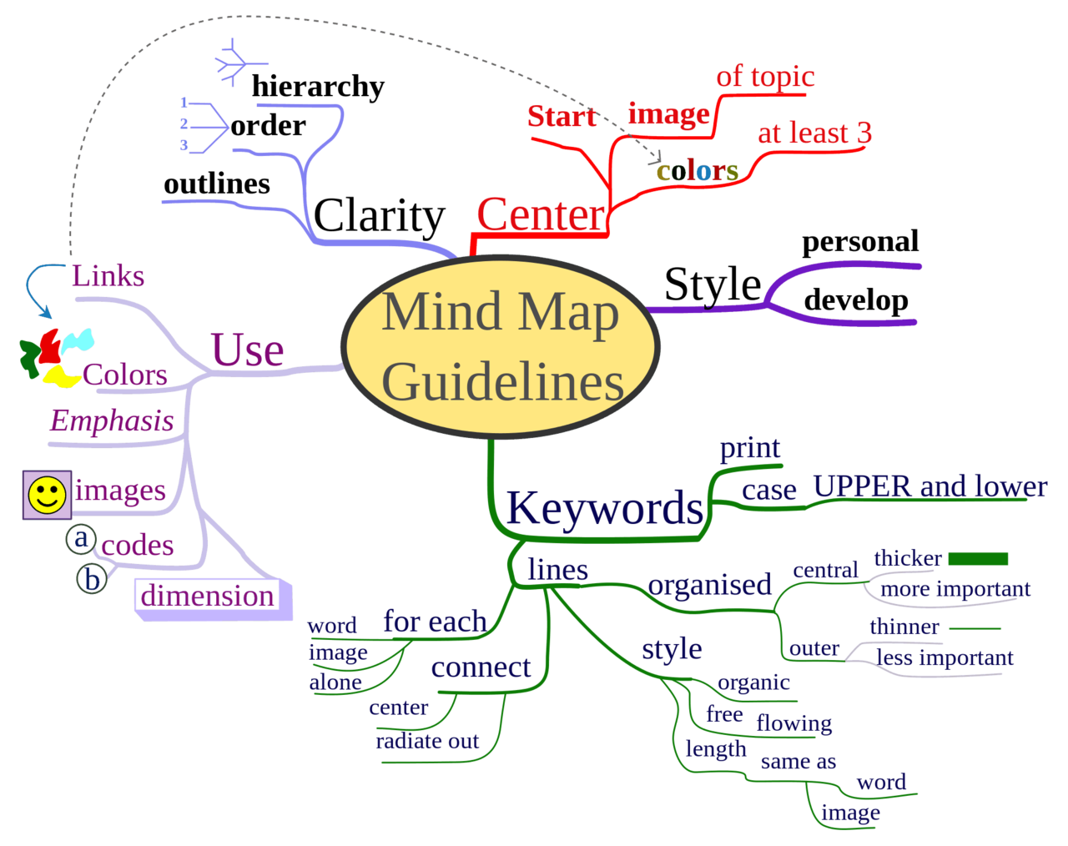
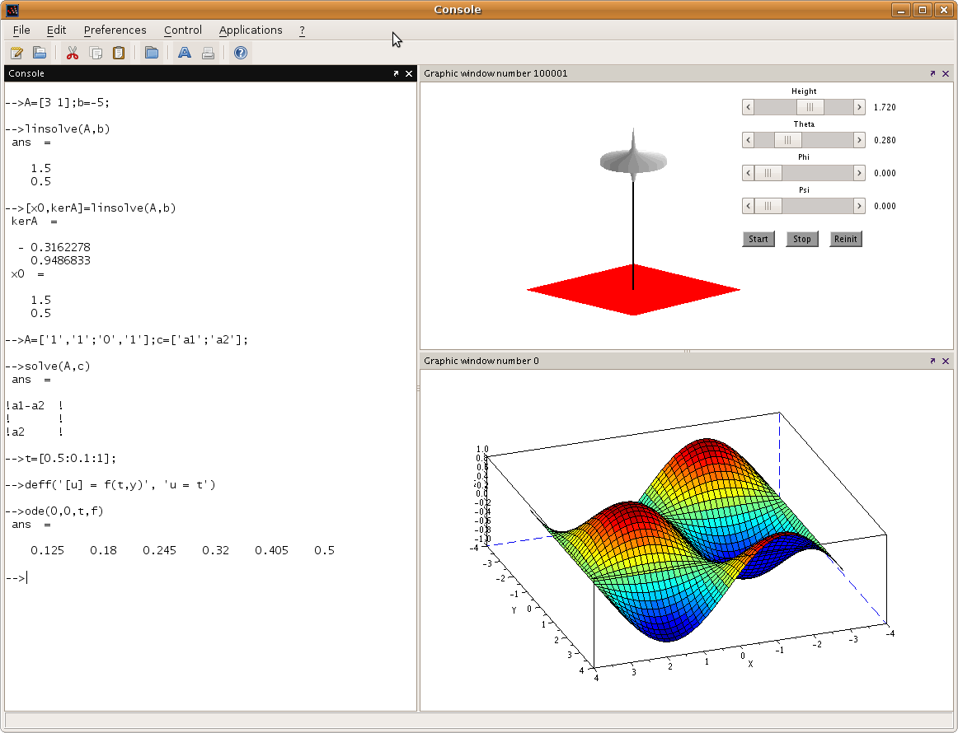

FOSS in Schools
The OSV catalogue has even more
Notes:
Planetarium / Solar System
Kstars, Stellarium & World Wind
Science
Periodic table & scientific calculators
Mind mapping / Brain storming
FreeMind, VYM
For the big kids: GIS & Statistics
Quantum GIS, R/Octave, SciLab & SciCraft analysis tool
Altruistic reason: if you support FOSS you directly help the recipients of the One Laptop Per Child program.

Slide 6

FOSS in Schools
Strathcona Baptist Girls Grammar School
60 workstations, RedHat
No user data is ever saved on any Linux workstation
Notes:
Strathcona Baptist Girls Grammar School 2007
Kim Perkins
“installation has been remarkably smooth with the exception of some "freezing" problems with the new AMD based machines. We have been working to iron these out and although they are performing much better, we still get a few freeze ups a week. This is surprising because I have been using RedHat on an earlier AMD based machine for about 8 months and it has never frozen. It appears to be a problem with either the video card or our particular model of processor. The iPlanet LDAP server has been excellent. It has the Posix stuff built in and has worked faultlessly. The workstations are very fast and the students enjoy the speed, especially when using grpahics programs. Our network is 100baset switched to all workstations so network response time is not an issue”

Slide 7
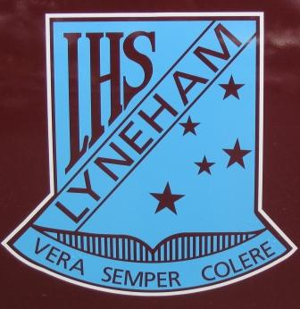
FOSS in Schools
Lyneham High School
The school was being quoted thousands of dollars
  “The choice was between learning something that would cost a lot of money or learning something that didn't” - Nick Oliver
Fantastic evaluation again
Plans to expand
Notes:
Lyneham High School ACT
Once again the evaluation speaks for itself:
“The finished network exceeds expectations in terms of reliability and power. No other school in the region has a server that has been up for as long or that provides as many users with as much functionality. Squid reduces considerably the monthly download bill.”
They even plan to expand its use
“Terminal services could offer the ability to reuse older workstations in areas of need like library, LOTE, homework centre and KLAs where costs of workstations are prohibitive”

Slide 8









FOSS in Schools
Around the world...
Notes:
Russia, macedonia, brazil, phillipines, India, China, South korea, the US, the UK and many others all have success stories of using FOSS and Linux in schools

Slide 9


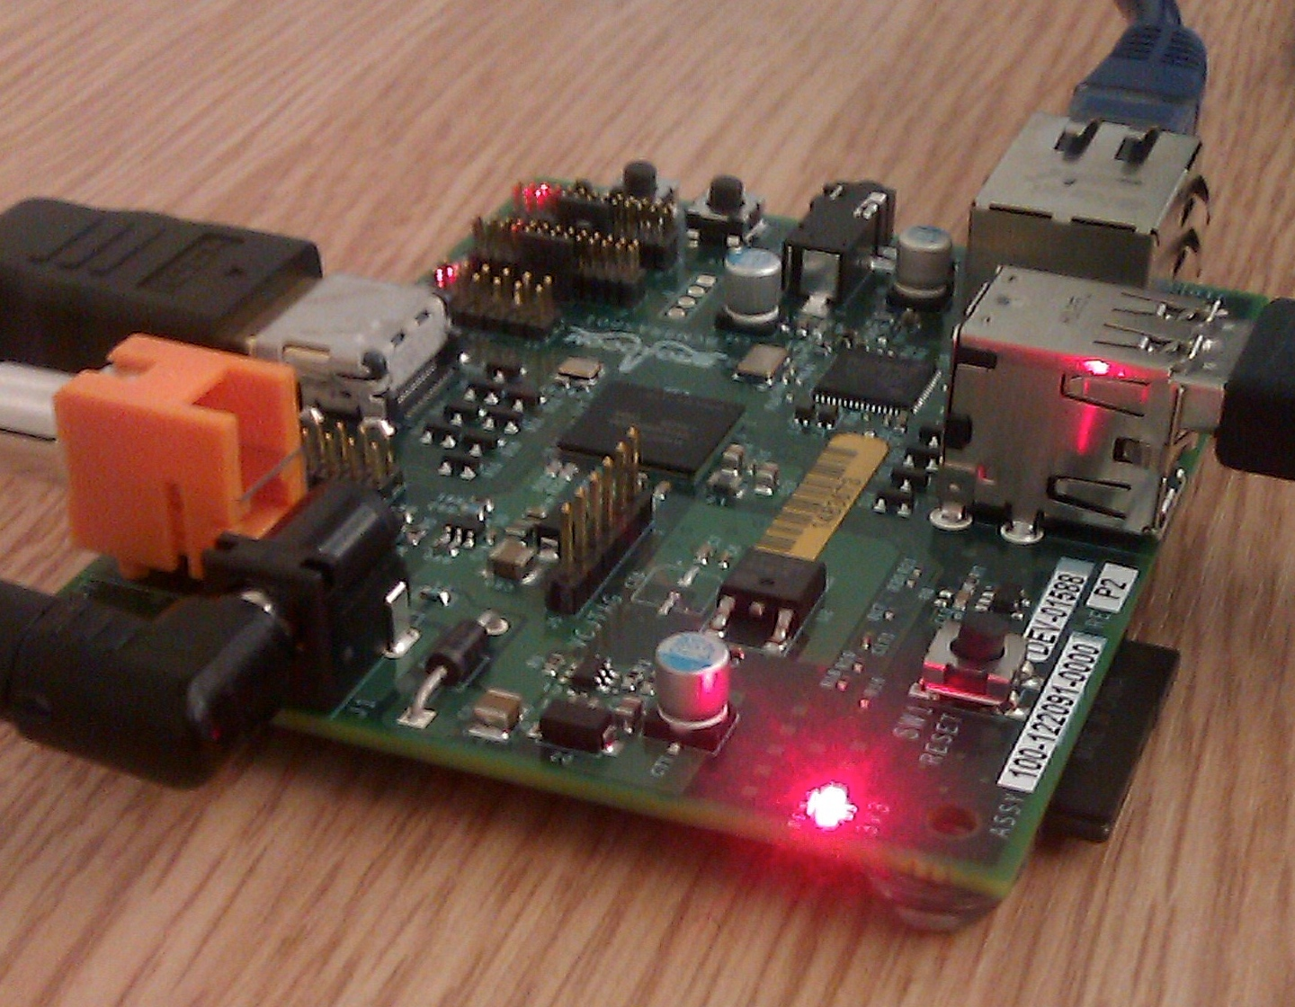
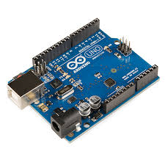
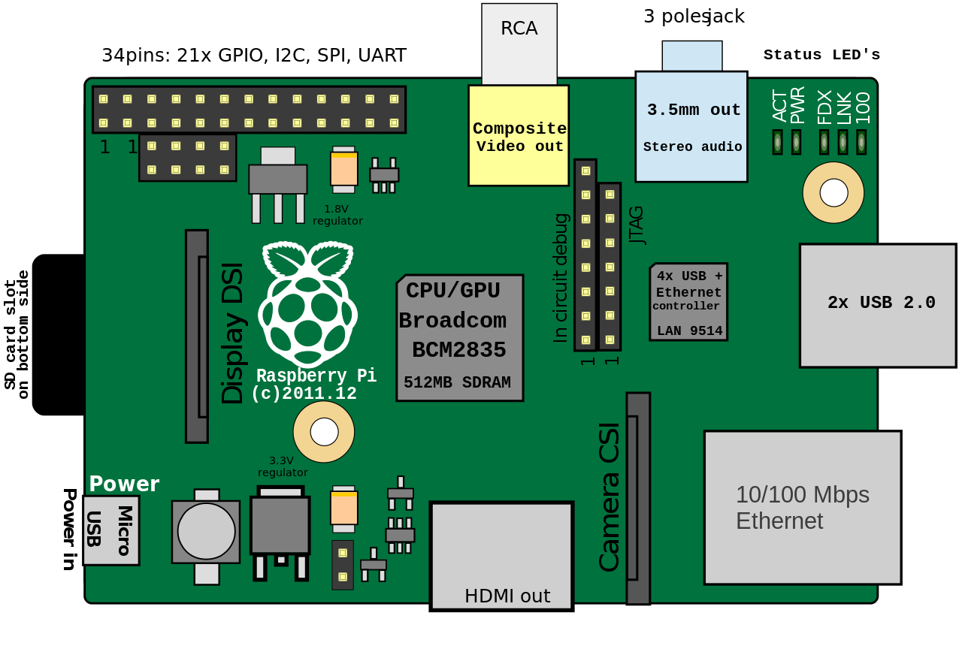
FOSS in Schools
Raspberry Pi & Friends
Notes:
Complete access to hardware
Free to study from the schematics to the graphics
Kid friendly default environment
Scratch
Educational Software
Sonic Pi
Last years S.F.D. talk

Slide 10
FOSS in Schools
REFERENCES
FSF: Why schools should exclusively use free software
OSV: Benefits of Open Source in Education
OSV: Catalogue
OSV: Further Reading
SchoolForge
Linux.org.au: Education
Strathcona Baptist Girls Grammar
Lyneham High School
Ingredients of an effective digital school
Images c/o Wikimedia
Notes:
references

Slide 11
FOSS in Schools
Questions or Comments?
Notes:
questions

